Slide 1
Test Automation Pipeline Enabling Critical Feedback For Your Quality Cycle
Maciek Konkolowicz
Software Quality Architect
Title Source Technology
Notes:
General Notes:
*Take screenshots instead of videos (LARGE)
*What value is there in logging in???
*NO LASER POINTING!!!!!!
*Take screenshots and put boxes to draw attention
*Full screen lower resolution
*Ignore template for screenshots
*Use the space that you need: IMAGE: Edge to edge
*Ditch videos and replace with screenshots
*Do not do videos inside the template
*Modify template to take up less room
-Paid vs. Free flowchart bogged down
-Customize to show other tools can be plugged in
-incorporate a few more points of view
-Use the logo and move it to bottom left , to free up some real estate
-Don’t use graphics for background , use powerpoint objects
-Bring back the story, lost in the middle, try to tie the threads

Slide 2


Slide 3
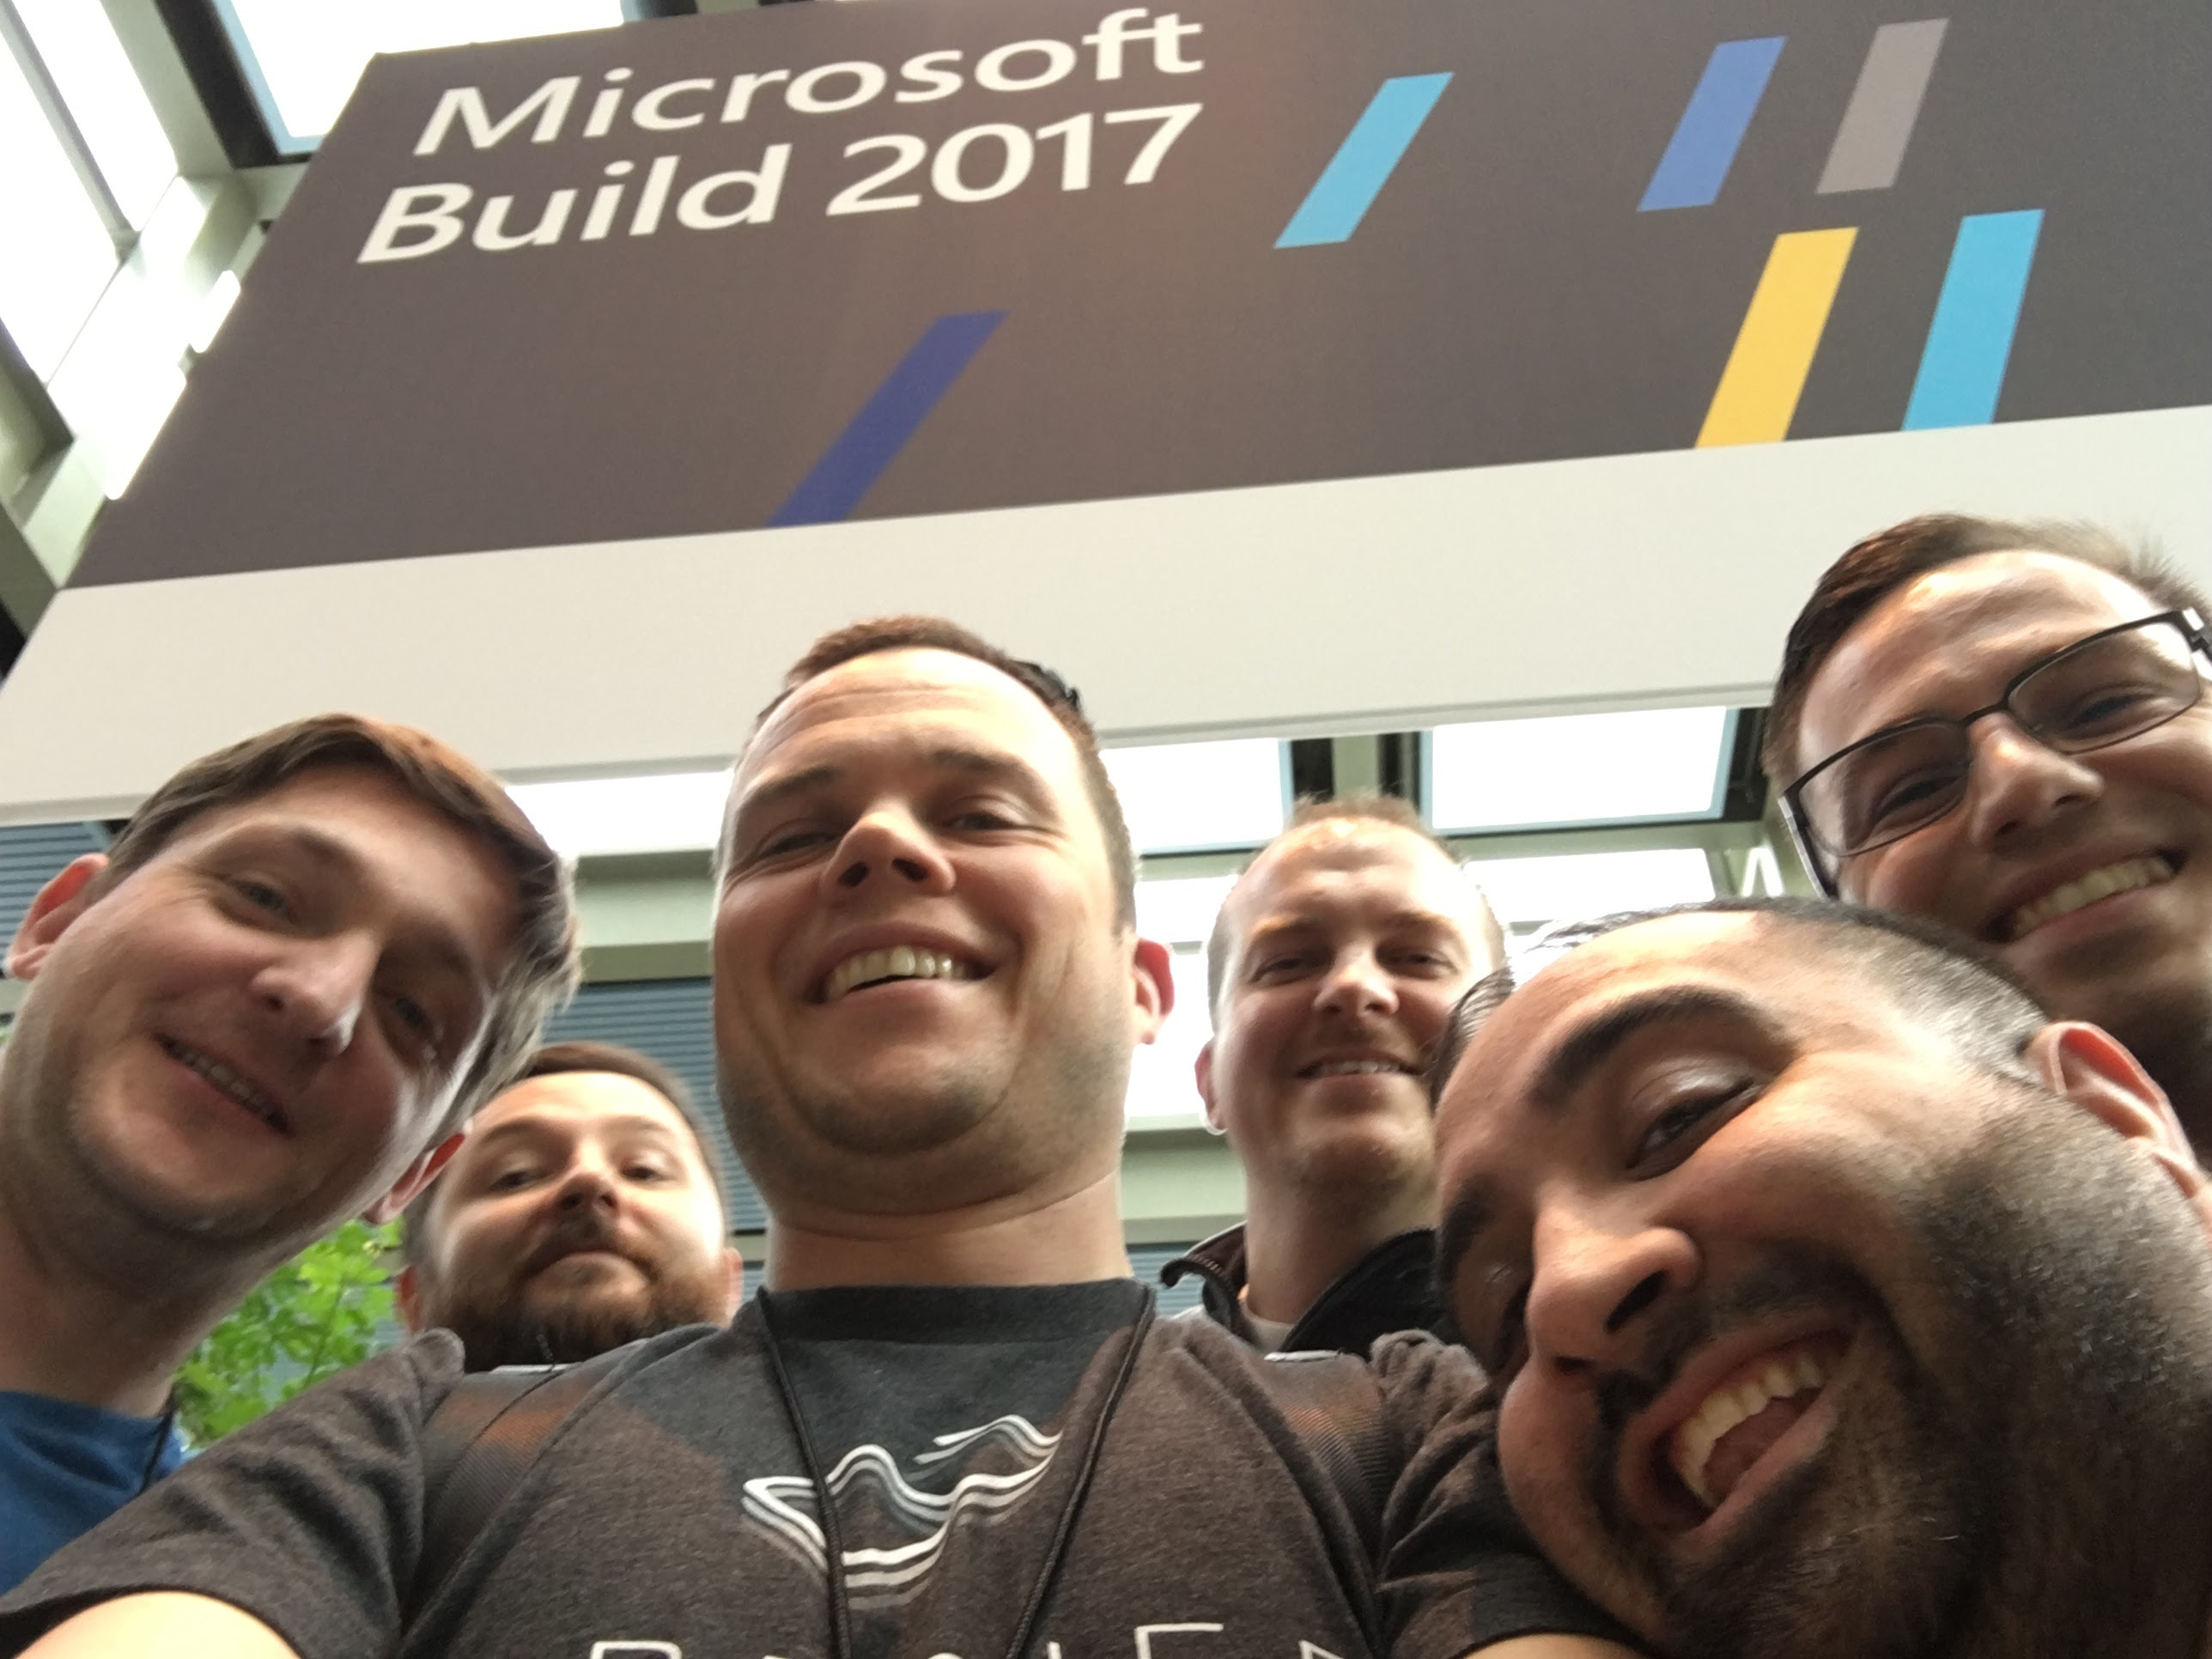
Notes:
I’m basically a curious tech dude, who came into the field of quality about 10 years ago. I’m a firm believer in using automated testing as a primary method of quality assurance. I love learning about new technologies and methods of assuring quality. I love helping people through knowledge sharing, coaching and encouraging testing as a team sport. In my spare time I love to race sailboats, ski and spend time with my friends and family.
NOTES: Break into 3 slides
-Enough title promotion in the title, can keep podcast and twitter

Slide 4
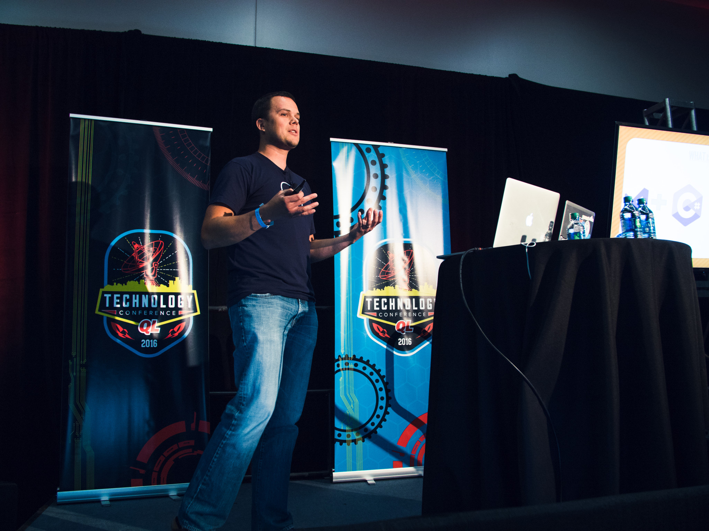

Slide 5


Shameless Promotion #1
@mkonkolowicz
http://macie-j.me

Slide 6

Shameless Promotion #2

Slide 7


Shameless Promotion #2
@TitleSourceTech
Title Source Tech
http://www.titlesourcecareers.com

Slide 8
Test Automation
Software to automate checking that humans shouldn’t need to do
Notes:
Notes:
-Feels like doesn’t belong
-Image that explains test automation
-Tweet of definition
-Good to gump
-Gump pipeline
-Then bring together with questions
Test automation refers to the automated test that are executed during an application’s development for the purpose of establishing quality.

Slide 9
Who Has A Test Automation Process?

Slide 10
Quiz Time!
Notes:
We’re going to take a quiz together.

Slide 11

Question 1: Can You Run One Test?
Notes:
1. Can you run one automated test?
Note:
Change test graphic to “actual test”

Slide 12
Question 2: Can You Run Many Tests?
Notes:
Maturity Level 2: Multiple tests running at once

Slide 13



Question 3: Can You Run Tests In Different Environments?
Notes:
Maturity Level 2: Multiple tests running at once

Slide 14


Question 4: Can You Scale Your Tests?
Notes:
4. Can you run many automated tests, in pre determined environments all at once?

Slide 15

Question 5: Can Anyone on Your Team Run & Examine Your Tests?
Notes:
4. Can you run many automated tests, in pre determined environments all at once?

Slide 16
How Did You Do?
Notes:
How many people were able to answer yes to all of the questions? Probably not many of you. But let’s not worry about results. Let’s look forward, to the future, let’s think of how we can improve.

Slide 17
Test Automation
Software to automate checking that humans shouldn’t need to do
Notes:
Seems like we have some degree of this. But we have room for improvement! But if we don’t have an effective way to organize, scale, and examine and run our test automation, what good is it anyway?

Slide 18
Notes:
Seems like we have some degree of this. But we have room for improvement! But if we don’t have an effective way to organize, scale, and share results of our test automation, what good is it anyway?

Slide 19
Test Automation Pipeline
A scalable process for delivery of automated checking that humans shouldn’t need to do!
Notes:
Notes:
-Feels like doesn’t belong
-Image that explains test automation
-Tweet of definition
-Good to gump
-Gump pipeline
-Then bring together with questions
Test automation refers to the automated test that are executed during an application’s development for the purpose of establishing quality.

Slide 20
Test Automation Pipeline
Notes:
Seems like although we have test automation, we have some problems with it. It seems like, we are lacking a way to deliver the test automation, to scale the

Slide 21
Test Automation Pipeline
Enable Scalable, Understandable, Team Wide Quality
Notes:
The test automation pipeline process will

Slide 22
But Wait…
I think I already have a test automation pipeline!!
Notes:
The Problems

Slide 23
Do You Already Have A Test Automation Pipeline?
Notes:
1. Can you run one automated test?
Note:
Change test graphic to “actual test”

Slide 24
Do You Already Have A Test Automation Pipeline?
Notes:
2. Can you run more than one automated test?

Slide 25








Do You Already Have A Test Automation Pipeline?
Notes:
3. Can you run more than one automated test in a pre-determined environment?

Slide 26


Do You Already Have A Test Automation Pipeline?
Notes:
4. Can you run many automated tests, in pre determined environments all at once?

Slide 27

Do You Already Have A Test Automation Pipeline?
Notes:
5. Do you know where to get results from?

Slide 28
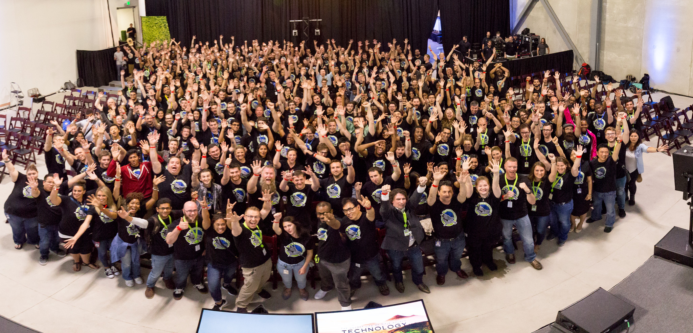
Can anyone on Your team do this?
Notes:
The benefit:
Anyone on the team, anytime, with results and timely execution

Slide 29
Test Automation Pipelines Solve This Problem
This is what the test automation pipeline gives you:
-all these awesome things through testing! (need a picture)
Notes:
-PROCESS
“A test automation pipeline involves:
*thing 1
*thing 2
*thing 3
*thing 4
“

Slide 30
DEFINITION

Slide 31

3 years Ago, Our Team Was Not Very Happy
Notes:
We found ourselves answering no, about 3 years ago, when we started a serious functional test automation effort.
We knew we wanted to get to a point where fast reliable feedback from scalable test automation was a given. We wanted to get to a place where the testing process was not a bottle neck for test feedback, but an enabler of quality for the team.

Slide 32
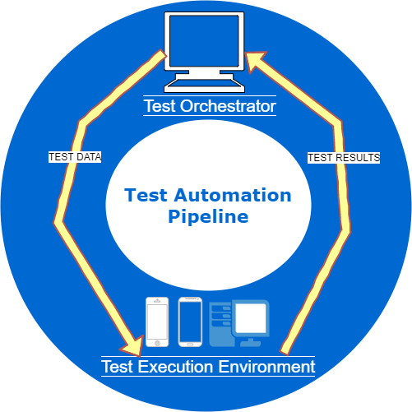









Push Button: Get Test
Notes:
We stumbled, poked and engineered our way through a process which I am going to present to you today. I hope to convince you that the idea of the Test Automation Pipeline is a necessary and important endeavor which when followed will enable your team to achieve the ultimate delivery model for test automation. “push button, get test”.

Slide 33
Test Automation Pipelines
Core Concept & Components

Slide 34
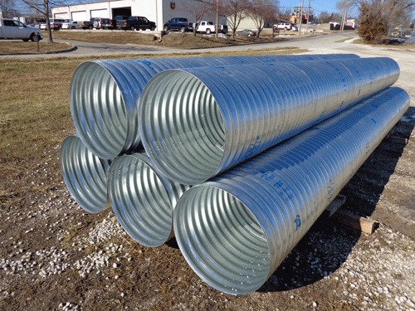
Test Automation Pipeline Core Concepts
Generic: Able To Support Testing For Any Product
Notes:
The concept of a test delivery channel can be implemented in multiple testing environments, languages and for different product types. The first core idea is that a stable, easy to use, fast pipeline exists for executing and providing feedback from test automation. The concept is generic and can be applied to different test environments, and is test agnostic!

Slide 35
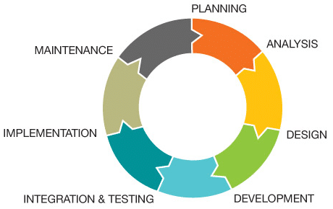
Test Automation Pipeline Core Concepts
Developed Early: Disambiguate Test Execution Problems
Notes:
The second core idea, is that this channel is established very early in a test automation effort. Early implementation of the channel allows for setup of the workflow which will force concentration on key concepts in test development, such as appropriate tests, stability and coverage, and prevent worrying about misleading execution issues.

Slide 36
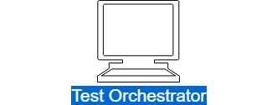
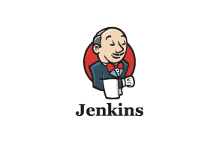

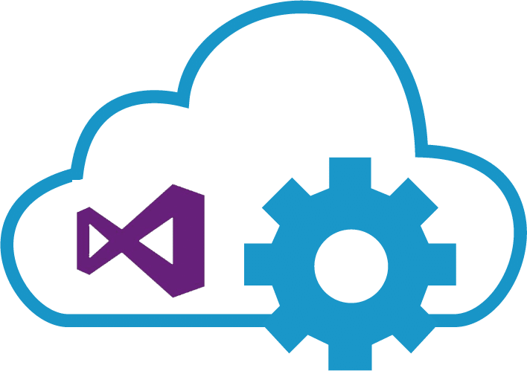
Components: Test Orchestrator
Git Test
Notes:
Part 1: Test Orchestrator
A test orchestrator is a device which will automatically organize and execute your tests. A test orchestrator does not have to (but can) have a single responsibility. A test orchestrator is absolutely necessary because it is responsible for organizing how, and where your tests are executed. It is also the device which receives feedback from your tests and organizes them in a digestible way.
Examples of popular test orchestrators include the "Test Controller" which is used in Microsoft's legacy "Test Manager/Lab Manager" testing infrastructure (See helpful link #1 below), Microsoft's Team Foundation Server (or Visual Studio Team Services) and The Jenkins Build System.

Slide 37
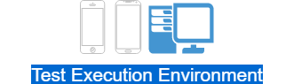




Components: Test Exe Environment
Notes:
Part 2: Test Execution Environment
A test execution environment is the set of machines or devices where your tests will run. It is the receiving end of the test automation delivery channel. The test execution environment receives tests from the test orchestrator, runs them and gives feedback to the test orchestrator about the test runs. The test environment should consist of many machines (which could be mobile devices too!) that will be able to run tests in parallel. The choice of which test execution environment depends on your team's needs

Slide 38
Notes:
So now that we know what a Test Automation Delivery Channel is, why we should have one, when to create it, and what it’s parts are, let’s take a look at how to create one.

Slide 39
Step 1: Pick A Test Orchestrator
Existing Infrastructure?
Y
Configure Existing!!!!
Notes:
Step 1: Pick A Test Orchestrator
In the slides above we established that a test orchestrator is a device which will automatically organize and execute your tests, and provide a way to view feedback. We noted that Microsoft’s Test Manager , TFS, VSTS or Jenkins are all acceptable test orchestrator types. Other industry specific orchestrators such as Quality Center are also acceptable choices. When picking our team’s orchestrators, I found myself answering the following questions, which narrowed my choice down:
Can I Piggyback On To An Existing Product Which My Team Is Using?
If the answer is yes, I would just stick with this product. I prefer to re-purpose tools, and in the interest of causing as little adoption friction as possible, would suggest you do too. Change is hard, why introduce additional layers of complication?
Note:
Add in yes and no

Slide 40
Step 1: Pick A Test Orchestrator
Existing Infrastructure?
N
Budget?
Open Source
N
Notes:
Step 1: Pick A Test Orchestrator
Do I have Money To Spend?
If you do not have an already existing solution, do you have a budget? If you do not have limits, you can go all out and hire a consultant to implement the latest and greatest build system for you, which that consultant will then hook up for you and you can simply start writing tests to be executed in.
If you do not have money to spend, you have to resort to a free open source test orchestrator. Which is not a bad thing, it is just different than a paid tool.
Note:
Add in Yes or No

Slide 41
Step 1: Pick A Test Orchestrator
Existing Infrastructure?
N
Budget?
Open Source
Paid Tool
N
Y
Notes:
Step 1: Pick A Test Orchestrator
Do I have Money To Spend?
If you do not have an already existing solution, do you have a budget? If you do not have limits, you can go all out and hire a consultant to implement the latest and greatest build system for you, which that consultant will then hook up for you and you can simply start writing tests to be executed in.
If you do not have money to spend, you have to resort to a free open source test orchestrator. Which is not a bad thing, it is just different than a paid tool.

Slide 42
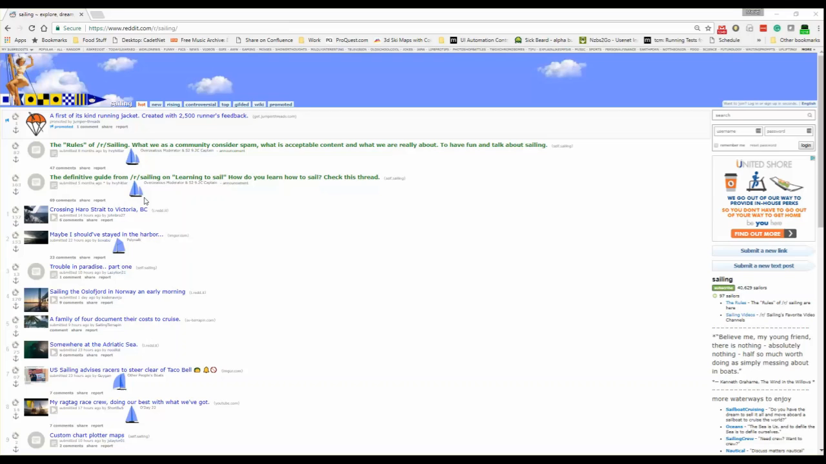
Our Choice: Existing Orchestrator
Notes:
My team was lucky enough to operate in an environment where TFS was already implemented, so we decided to stick to it. Also, because of this, for the purpose of this presentation, we are going to focus on the online version of TFS (VSTS) which is available for free use by small teams.

Slide 43
Step 2: Pick A Test Environment
Existing Environment?
Y
Supports Product Tech Stack?
Y
Configure Existing!!!!
Notes:
A test execution environment is the set of machines or devices where your tests will run. The main decision point for picking this environment is what technology is your product operating in? Are you supporting a desktop application? A mobile product? A web app? You need to match your test execution environment(s) to the products you are supporting.
Each technology stack can be supported by a series of different execution environments.
A test execution environment can be housed internally, or externally. Similarly to the Test Orchestrator, you have to ask yourself a few questions:
Do I have existing infrastructure I can use for testing?
Do I have money to spend on infrastructure for testing?
In this situation, I would suggest that offloading maintenance of environments is the best choice even if internal existing infrastructure exists. Treating infrastructure as a service will allow your team to focus on what their primary deliverable is: maintainable, scalable, appropriate tests.
If you are forced to use internal infrastructure (see next slide) you will want to ensure to minimize environmental variability.

Slide 44
Step 2: Pick A Test Environment
Existing Environment?
N
Budget?
Skillfully Acquire
Paid Tool
N
Y
Beg for $
Notes:
A test execution environment is the set of machines or devices where your tests will run. The main decision point for picking this environment is what technology is your product operating in? Are you supporting a desktop application? A mobile product? A web app? You need to match your teste execution environment(s) to the products you are supporting.
Each technology stack can be supported by a series of different execution environments.
A test execution environment can be housed internally, or externally. Similarly to the Test Orchestrator, you have to ask yourself a few questions:
Do I have existing infrastructure I can use for testing?
Do I have money to spend on infrastructure for testing?
In this situation, I would suggest that offloading maintenance of environments is the best choice even if internal existing infrastructure exists. Treating infrastructure as a service will allow your team to focus on what their primary deliverable is: maintainable, scalable, appropriate tests.
If you are forced to use internal infrastructure (see next slide) you will want to ensure to minimize environmental variability.

Slide 45
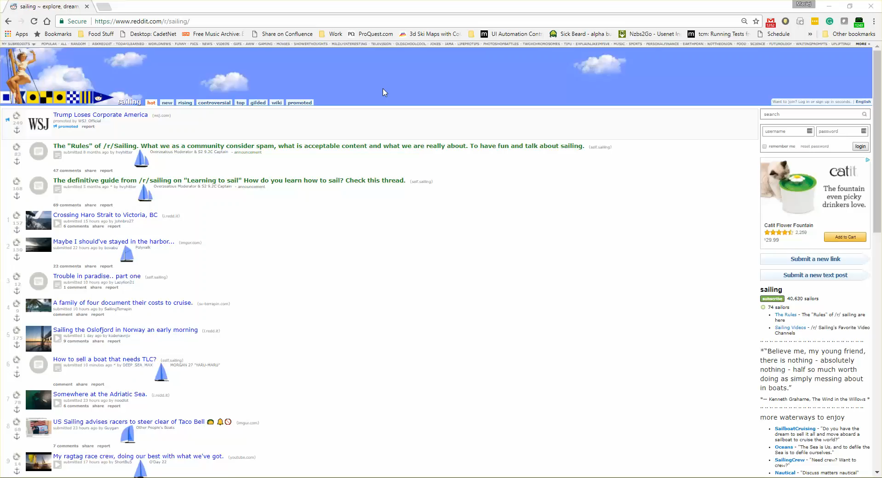
Our Choice: Sauce, XTC and MTM
Notes:
Our team is responsible for maintenance of web, mobile, and desktop applications. For our Web presence we chose SauceLabs (and Selenium Grid), Xamarin Test Cloud and Microsoft Test Lab as our execution environment choices.
As noted, we tried to go with 3rd party environments for the purpose of scale, and to ensure our focus was on writing tests and figuring out scenarios, and not maintaining devices and VMs. Unfortunately, we had no choice but to do so with our desktop application.

Slide 46
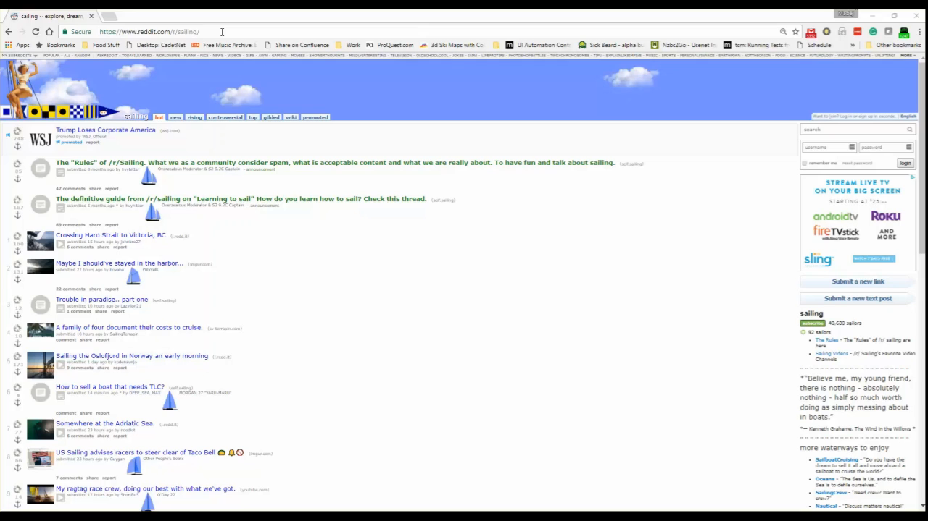
Our Implementation: Sauce, XTC and MTM
Notes:
Our team is responsible for maintenance of web, mobile, and desktop applications. For our Web presence we chose SauceLabs (and Selenium Grid), Xamarin Test Cloud and Microsoft Test Lab as our execution environment choices.
As noted, we tried to go with 3rd party environments for the purpose of scale, and to ensure our focus was on writing tests and figuring out scenarios, and not maintaining devices and VMs. Unfortunately, we had no choice but to do so with our desktop application.

Slide 47
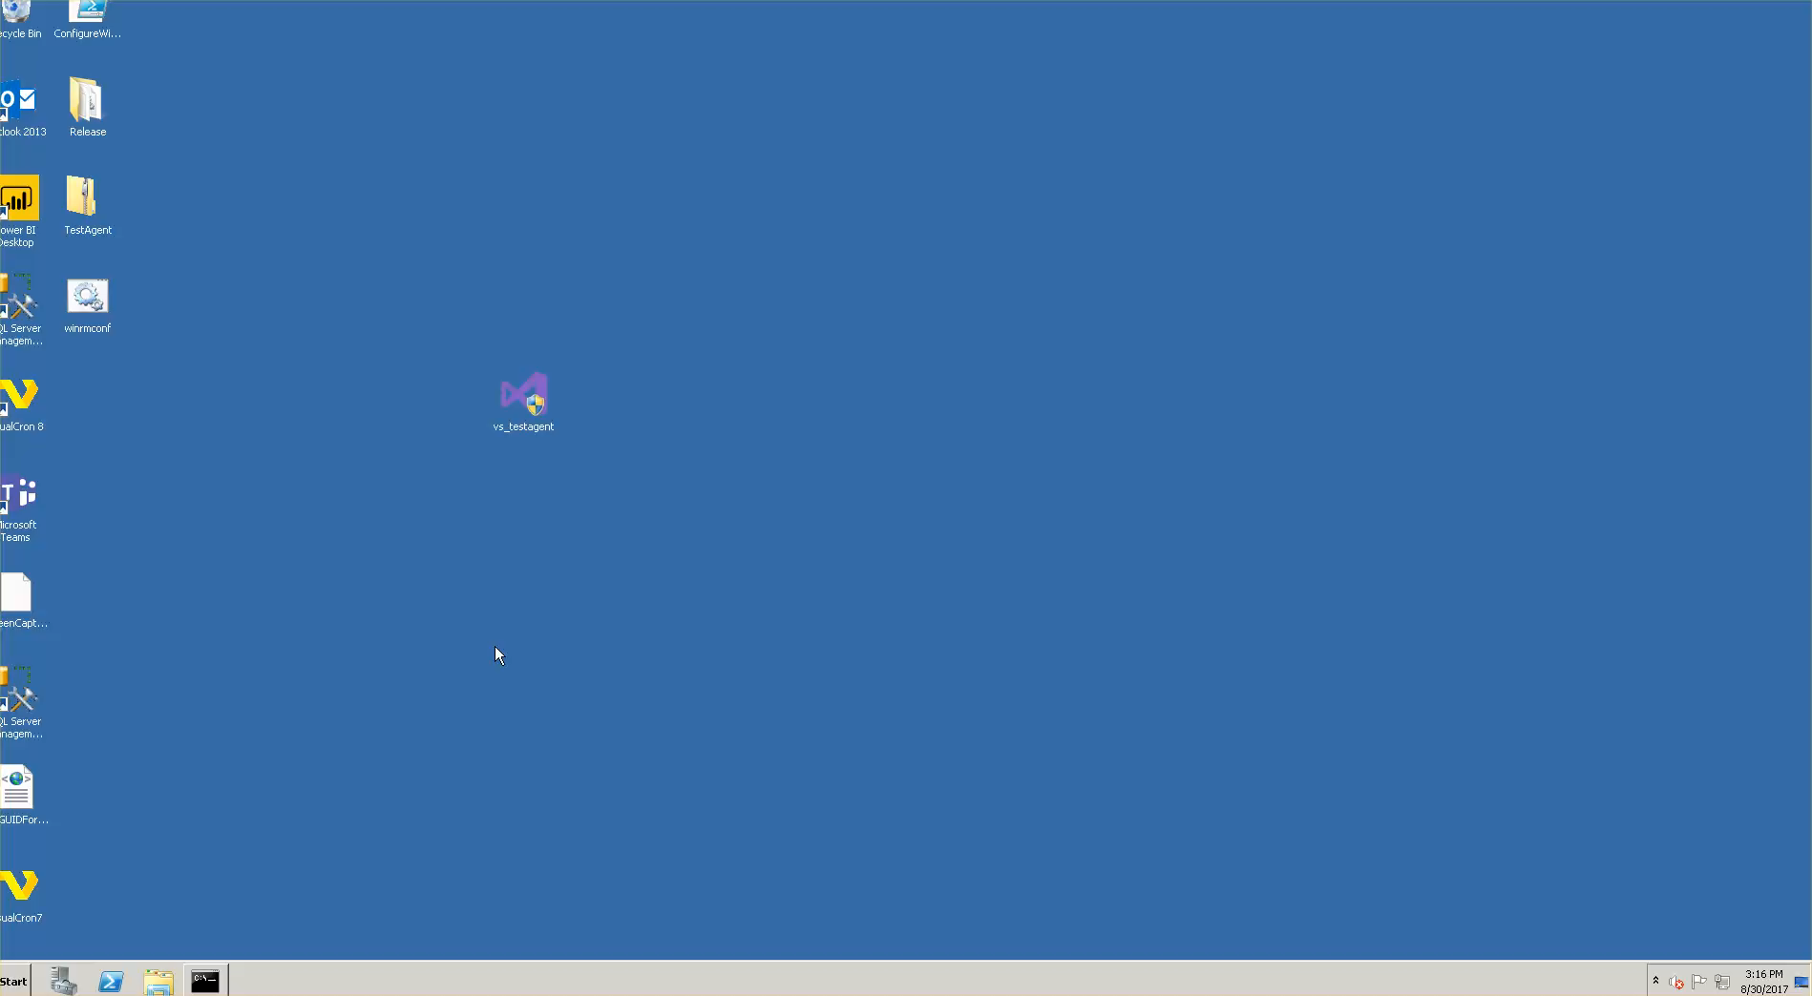
Our Choice: Sauce, XTC and MTM
Notes:
Our team is responsible for maintenance of web, mobile, and desktop applications. For our Web presence we chose SauceLabs (and Selenium Grid), Xamarin Test Cloud and Microsoft Test Lab as our execution environment choices.
As noted, we tried to go with 3rd party environments for the purpose of scale, and to ensure our focus was on writing tests and figuring out scenarios, and not maintaining devices and VMs. Unfortunately, we had no choice but to do so with our desktop application.

Slide 48

Step 3: Hook Up Your Components
CONNECTIVITY
Notes:
Notes: Symbolize connection with line instead of graphic in the middle
Once you pick your test orchestrator and execution environment, you will need to hook them up. The one thing which you absolutely cannot assume is communication between the execution environment and the test orchestrator. This is something which has to be confirmed as early as possible. In our environment, this is one of the larger hurdles we had to get over, due to infrastructure setup. The worst part of setting up the test automation channel was waiting for network infrastructure adjustments to allow communication from the test orchestrator to the test environment. It would be in the best interest of the test automation effort to get over this hurdle with at least one machine or device in the execution environment.

Slide 49
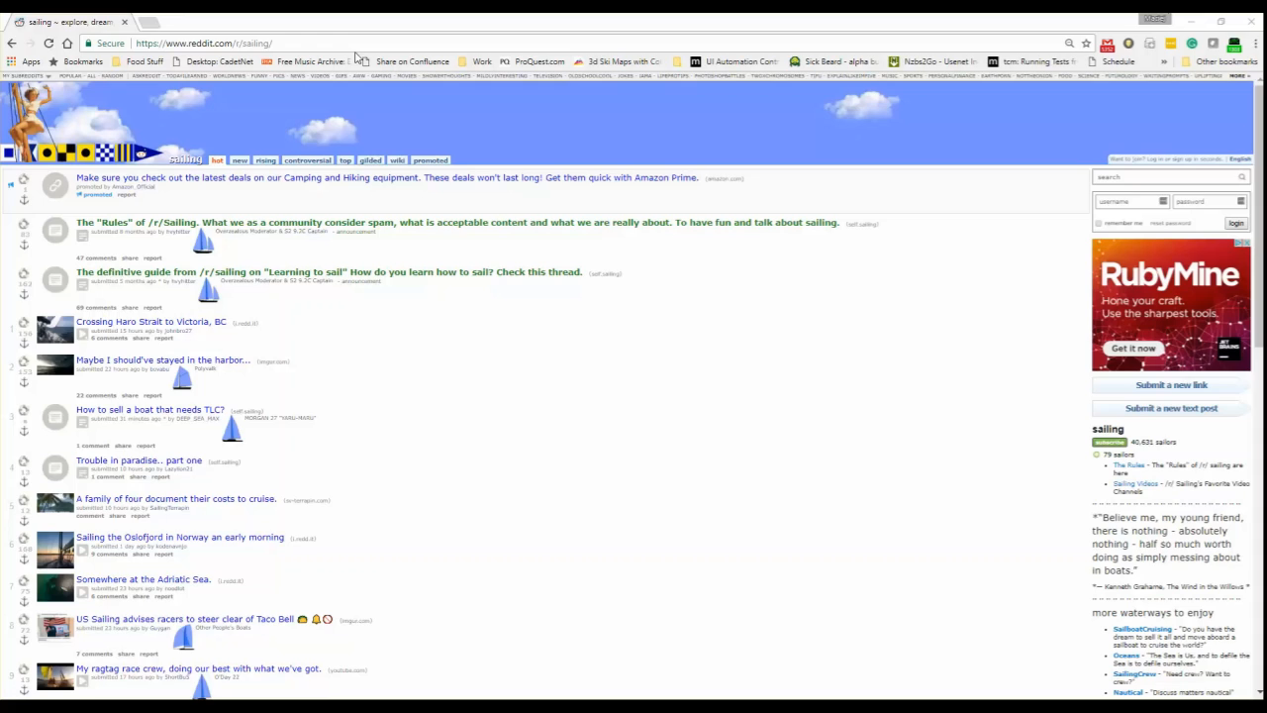
Our Choice: Adding Machines In TFS
Notes:
Note that videos of adding machines in Jenkins and TFS with SauceLabs can be found in the git repo.

Slide 50
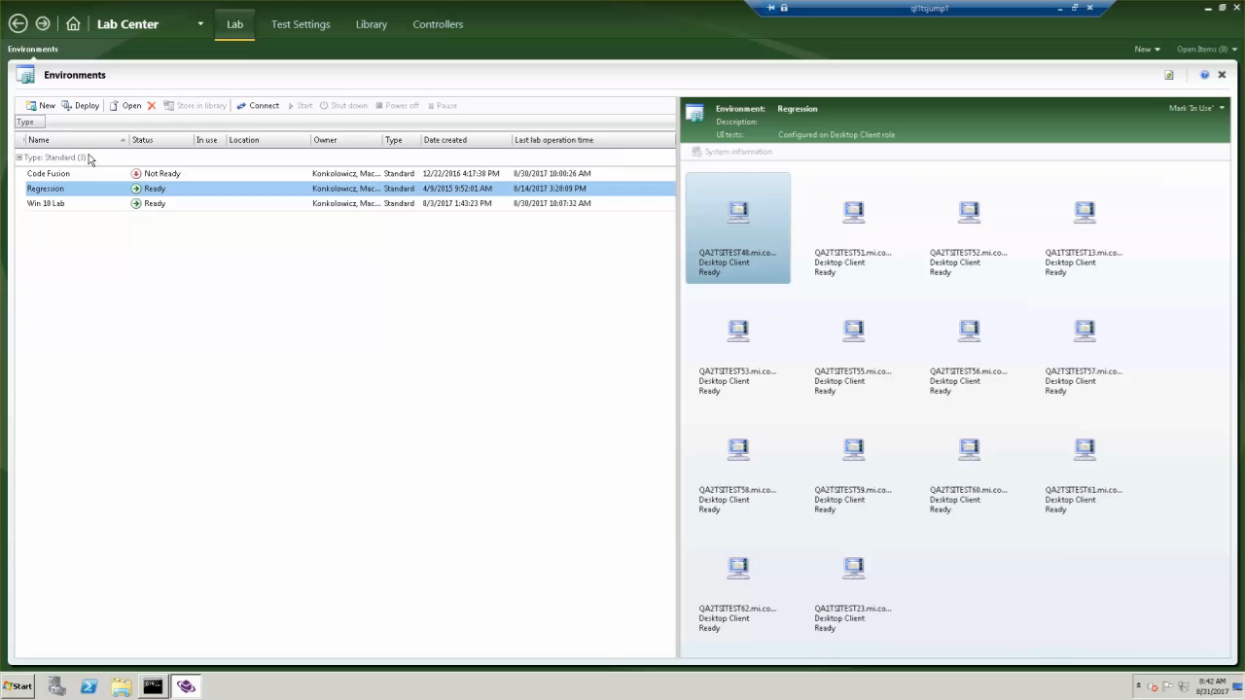
Our Choice: Adding Machines In MTM
Notes:
Note that videos of adding machines in Jenkins and TFS with SauceLabs can be found in the git repo.

Slide 51


Step 4: Define Your Trigger Strategy
Which Rate Is Right For Your Team?
Notes:
Notes:
-Image backgrounds should match
-Use ppt to match colour backgrounds
Once you have decided your test orchestrator, execution environment and confirmed at least one device or machine in the execution environment can communicate with the test controller, it's time to define how often your tests will run. This decision is again specific to what your team needs, the execution time of your tests, and the cost for execution. Your trigger strategy should depend on how quickly your team needs to receive feedback from your test suite. Ideally, your test suite execution should align with your deployment strategy. The more frequently you deploy your product, the more frequently you should run your test suites to validate functionality.
Do you need a musket or a machine gun? It’s up to you and your team?

Slide 52
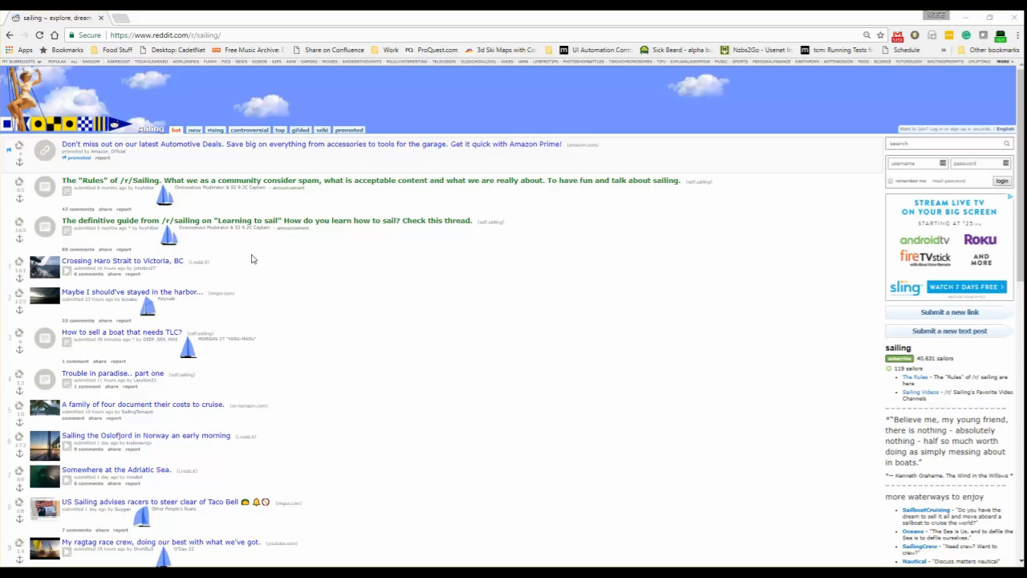
Our Setup: Nightly Automated Runs
Notes:
We setup nightly runs, because we have multiple pushes a day to our environments. Ideally, we would have multiple test runs, but realistically, daily feedback is fast enough for our teams, which operate in a two week cycle.

Slide 53
Step 5: Define Your Execution Steps
Copy
Deploy
Test
Publish
Build
Notes:
Notes:
Don’t let your theme dictate your assembly
Before we run tests, we have to think of any pre-requisite tasks that need to be executed. As with implementing the trigger strategy, this is fairly environment specific but worth talking about from a strategic perspective, since it takes some thought.
One has to think about executing any pre-requisites necessary for a test run. It is best to assume that our environment will be barren, and we have to ensure anything which we will need to add for our product under test to work, will have to be copied in, installed, or injected in some other way. We also have to think about where our test code is coming from, and how it will be executed. In most situations that I've experienced, we pull test source code from a repository, and then compile it, before being able to execute it.
What pre-reqs are necessary for you to run tests in your environment?

Slide 54
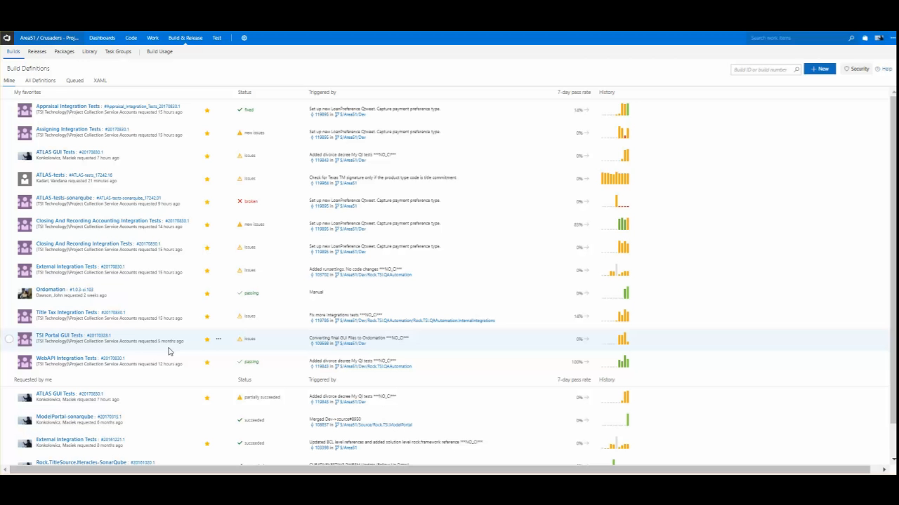
Our Setup: Build,Copy,Deploy,Run,Publish
Notes:
Notice there are many pre-requisite steps we have to follow to get the tests to run, including how to find the dlls.

Slide 55
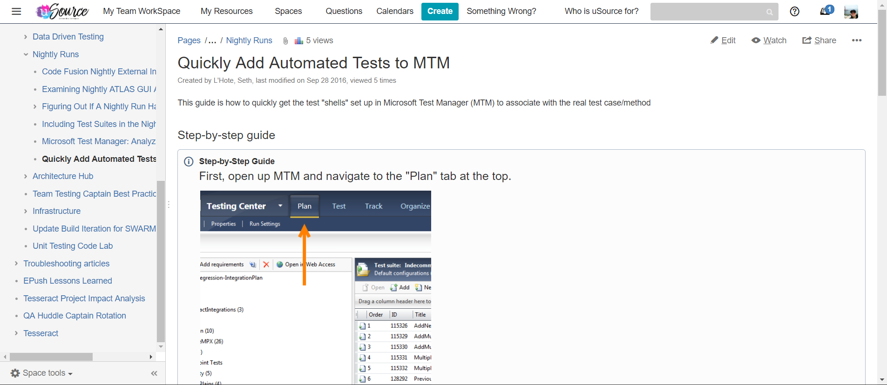
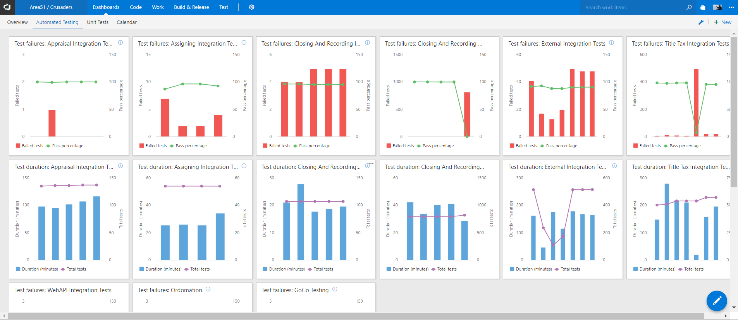
Step 6: Educate Your Team
Notes:
Notes: SPLIT INTO 3 (take the picture of the presenter)
The last piece in establishing a successful Test Automation Delivery Channel is probably the hardest. One of the biggest potential gains of test automation is its' ability to be executed and examined by folks who did not write it. The idea that a Business Analyst or Developer could use tests written by a Test Engineer to ensure quality is delivered for a feature change, allows a team to eliminate bottle necks and increase delivery speed. But in order to do this, they (your team) needs to be educated on how to run tests and analyze results.
Blog Posts
Word Of Mouth
Regular Summaries
Dashboards

Slide 56
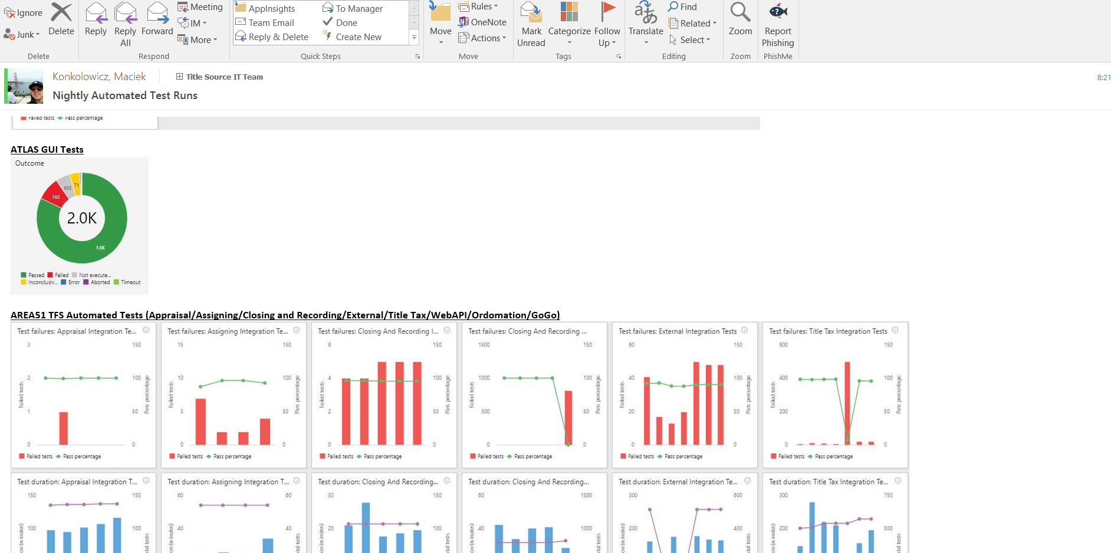
Our Setup: Summary Emails
Notes:
On our team we have used nightly summary emails as megaphones for automation quality. As part of this quality communication we also talk about test automation delivery channel stability. If we see build failures or test run abortions, we communicate to the entire team and ask for folks to step up an

Slide 57
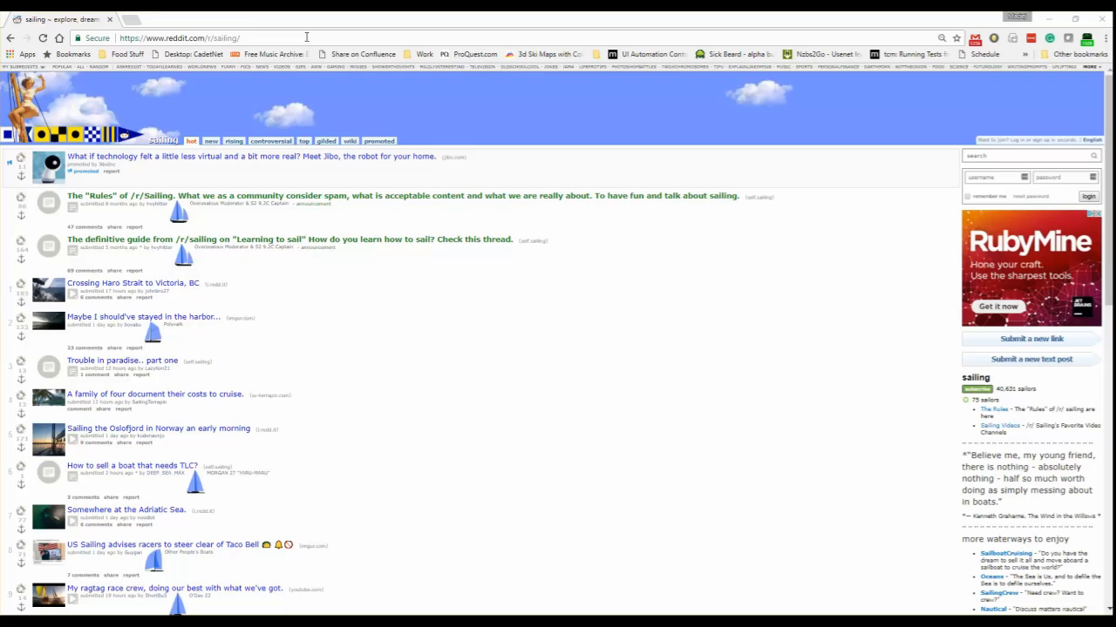
Our Setup: Dashboard
Notes:
This is an example of a dashboard. It gives the team the ability to drill in from a strategic perspective all the way to individual tests.

Slide 58
Test Automation Pipeline: Setup Summary
1. Orchestrator
2. Test Environment
3. Hook up Components
4. Trigger Strategy
5. Execution Steps
6. Education
Notes:
So now that we know what a Test Automation Delivery Channel is, why we should have one, when to create it, and what it’s parts are, let’s take a look at how to create one.

Slide 59
Enabling Our Quality Success Story
Notes:
Early setup of a Test Automation Pipeline really helped my team focus on writing tests that could be reliably executed, and scaled.
By designing and implementing the pipeline before focusing on producing a significant amount of tests, we ensured that when we did produce a significant amount of tests (thousands of them!), we were not worrying about why tests were not able to be executed or were not executing fast enough.
We have followed the above-outlined channel design process multiple times, and each time found that it enabled us to focus on figuring out what to test, instead of how to run tests.

Slide 60
Test Automation Pipelines
What It Meant For Us

Slide 61
Win: Speed
Test Automation Pipelines
0
Many
4000
Tests
UI
UI
Integration
1000
3.5hr
3hr
Tests
500
< 50
Tests
Tests
2014
2017
Time in Years
Notes:
Speed (Short Feedback Scaled) *Year 1: No automation, pipeline created for Desktop product *Year 2: 500-1000 test cases in automation for Desktop product, pipeline created and scaled, time to run 500 test cases: 3 hours *Year 3: 1000-2000 test cases in automation for desktop product, time to run 1000 test cases: 3 hours, pipeline scaled out to handle *Current: 4000 test cases, multiple pipelines created in automation for desktop product, time to run 4000 test cases: 3.5 hours, pipelines scaled out to handle
Notes:
Throw out the pyramids
Throw out the “tests”
Simplify the colours
Get rid of the arrows, de-complicate the slides

Slide 62








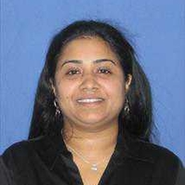











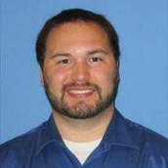



Win: Team Involvement
Test Automation Pipelines
0
Many
2014
2017
Time in Years
Notes:
Team Involvement (Cross Functionality) *Year 1: No automation, test automation pipeline for desktop created *Year 2: UI Automation ran and designed by nightly runs and SQAs *Year 3: Pipeline created for integration tests, Integration tests ran automatically, designed and implemented by QAs and BAs, and Devs.
Notes:
-Don’t use people’s pictures
-Use representation
-Don’t use template, full screen

Slide 63
HUGE WIN Enabled Quality Culture
Notes:
-Don’t change the focus (colour palette)
-Maybe it’s a visual (person across finish line)

Slide 64
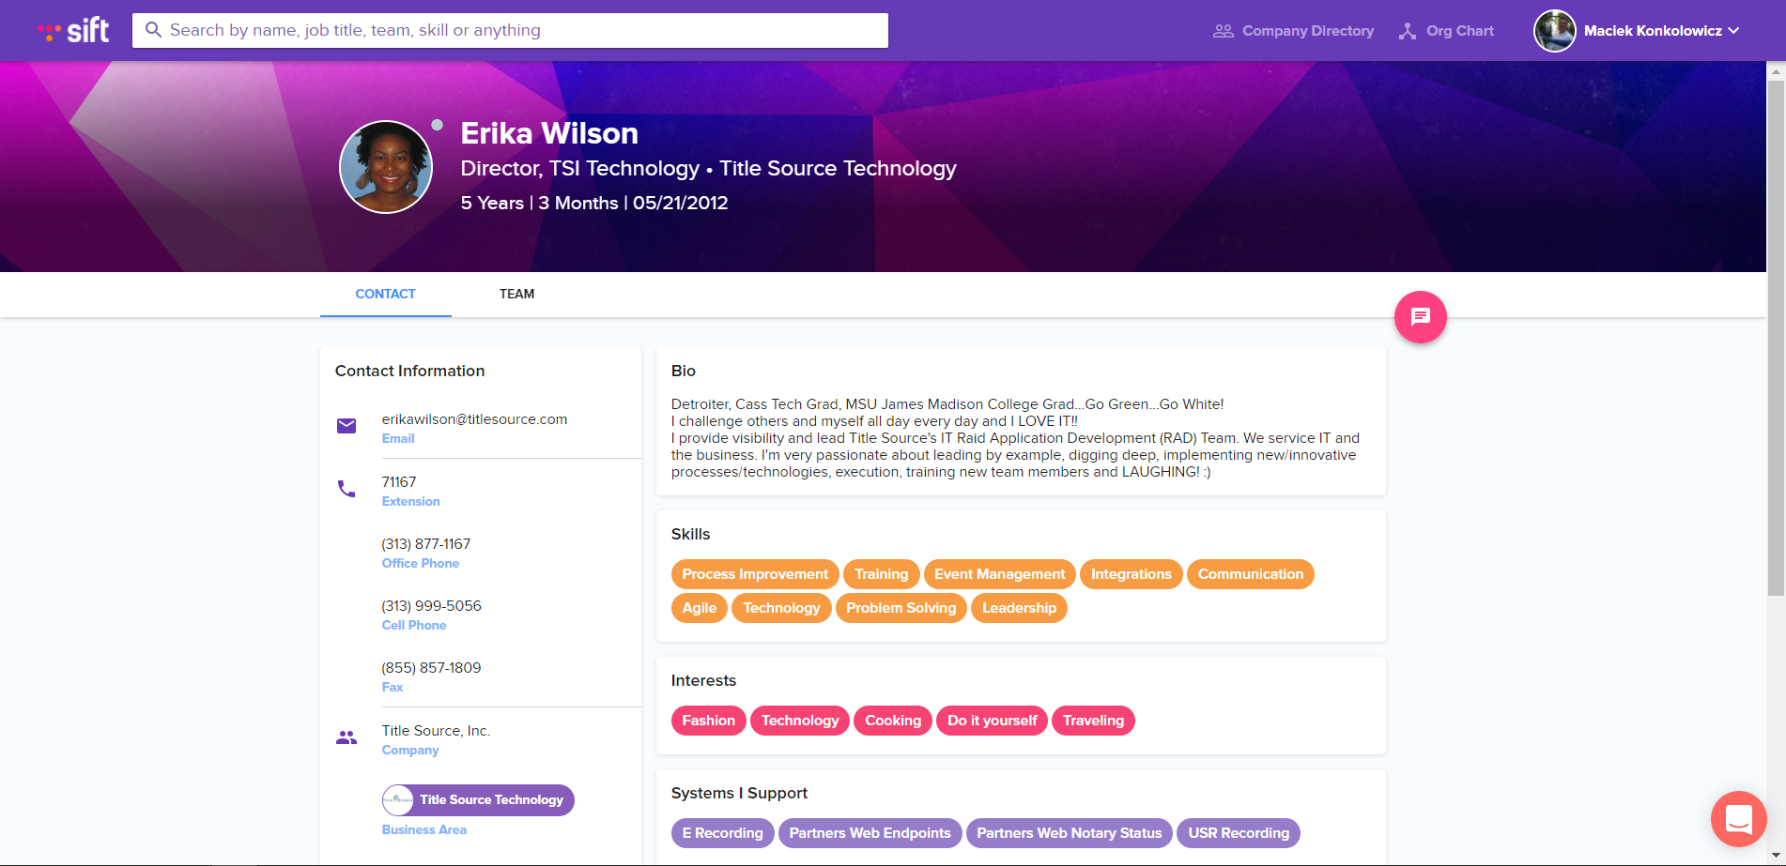
Erika Wilson
Notes:
Notes:
High res image of Erika, too busy w Sift
Enabling Quality For Team Erika is a director on one of our teams. Although we have a shallow organizational structure, she is two levels below the CIO. In late August, she spotted a drop in our nightly runs for one of our teams. She raised the alarm bell right away, to the team lead, to the Quality Engineer who was already investigating the issue. This isolated incident is a perfect example of what we were striving for at the design of the automation process, which our Test Automation Pipeline enabled. The automation pipeline enabled our teams to turn on the flow of quality throughout our entire software development life cycle. In this presentation I have talked about the concept, it's components, benefits and shown an example of how to implement one. I hope that you go to your teams, and regardless of your role, begin implementing your own test automation pipeline, to raise your teams product quality. Thanks so much for your time and attention.

Slide 65
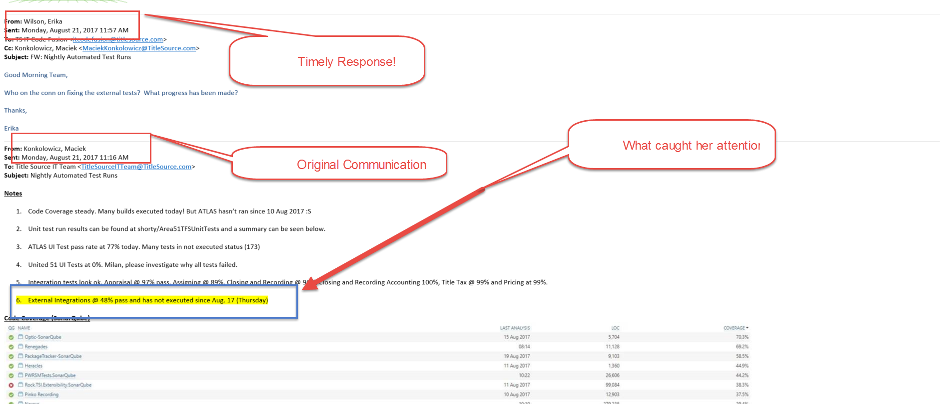
Erika’s Drive For Quality
Notes:
Notes:
-Tell story, get rid of the email
-The key message is the email triggered the action (put email icon)

Slide 66
Test Automation Pipeline Enable Quality In Your Entire Team
Notes:
Because our teams never focused on where to run automation, since we designed the pipelines at the beginning of our projects, they were able to focus on spreading quality to the entire team. Erika's team is a perfect example. Because the test automation channel was stable, she was able to rely on the results for consistent daily feedback after automatically triggered runs.

Slide 67


Thank You Title Source Tech!
We tweet!
We podcast!
http://www.titlesourcecareers.com
Notes:
I love the place I work, and have to give big credit to our culture for enabling my growth as a person and technologist. My team has supported me through the design and implementation process of this talk and I couldn’t have done it without them. Title Source Tech is a really great medium sized team, filled with smart passionate people. If you’re passionate about technology, and love to share your knowledge, come check us out! We’d love for you to join us!
Notes:
-Font size for pictures too small

Slide 68
Thanks For Your Time!
@mkonkolowicz
http://macie-j.me

Slide 69
Resources
Git Test

